Slide 1
Outline
Controlling laptop working with hand gestures(like a mouse)
Submitted in the partial fulfillment for the award of the degree of
BACHELOR OF ENGINEERING
IN
Big Data Analytics
Introduction Problem Formulation
Preliminary design of the project
Methodology used in the project
Analysis of features
Submitted by:
Kaustubh Naithani 20BCS4000
Prashant Kumar 20BCS4363
Dhruva Malik 20BCS3976
Mohammed Bilal 20BCS3994
Under the Supervision of:
Dr Monika Singh
Department of AIT-CSE
DISCOVER . LEARN . EMPOWER

Slide 2
Outline
NTRODUCTION
I
Introduction Problem Formulation
Preliminary design of the project
Methodology used in the project
Analysis of features

Slide 3
I
NTRODUCTION
Computers have seamlessly integrated into our daily routines, simplifying human-computer interaction (HCI). However, individuals with disabilities face distinct challenges in utilizing these devices effectively. This project introduces a gesture-based AI virtual mouse system, leveraging computer vision to execute mouse tasks using hand movements and fingertip detection. The system's core objective is to replace the conventional mouse with a web or built-in camera, enabling cursor control and scrolling through hand gestures.

Slide 4
I
NTRODUCTION
Computers have seamlessly integrated into our daily routines, simplifying human-computer interaction (HCI). However, individuals with disabilities face distinct challenges in utilizing these devices effectively. This project introduces a gesture-based AI virtual mouse system, leveraging computer vision to execute mouse tasks using hand movements and fingertip detection. The system's core objective is to replace the conventional mouse with a web or built-in camera, enabling cursor control and scrolling through hand gestures.

Slide 5
PRELIMINARY
DESIGN OF
THE PROJECT
The initial design of the project is to have the following components
MediaPipe :- To work with Hand Gestures
OpenCV :- To work with camera and create frames
An User Interface on which the person making hand gestures is visible while using hand gestures
Making the hand landmarks visible as an overlay on the hand.
Python to code all these functionalities

Slide 6
P
RELIMINARY DESIGN OF THE PROJECT
The initial design of the project is to have the following components
MediaPipe :- To work with Hand Gestures
OpenCV :- To work with camera and create frames
An User Interface on which the person making hand gestures is visible while using hand gestures
Making the hand landmarks visible as an overlay on the hand.
Python to code all these functionalities

Slide 7
M
ETHODOLOGY USED IN THE PROJECT
The following methodology is being used in the project
Step 1:- Selecting the library to work with human hand gestures and working out how it would fit in the project.
Step 2:- Finding the best possible way to combine Mediapipe with OpenCV to capture frames and recognise Hand Gestures.
Step 3:- Using the recognised hand gestures to perform various computer mouse functionalities.
Step 4:- Debugging and making sure that everything works and exceptions are handled properly.

Slide 8
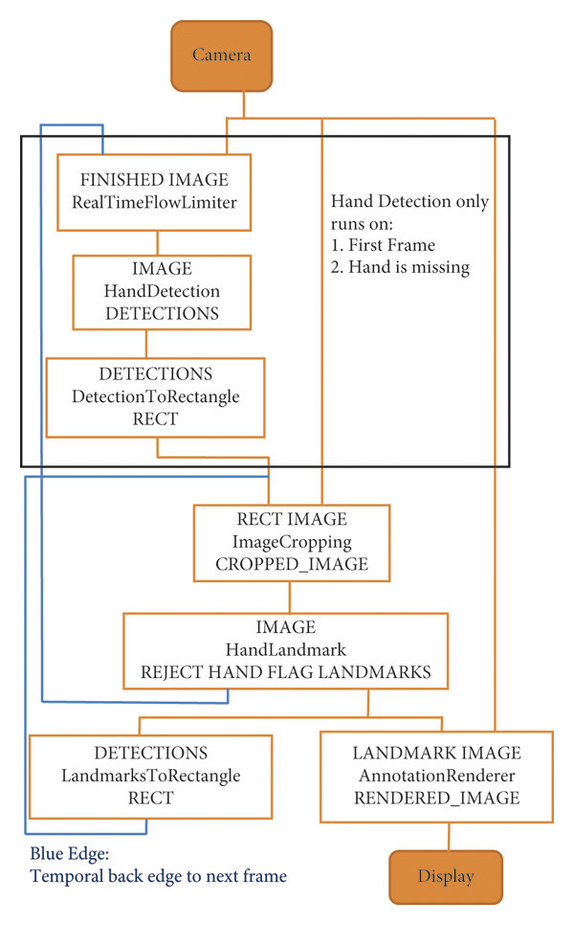
M
ETHODOLOGY USED IN THE PROJECT
The following methodology is being used in the project
Step 1:- Selecting the library to work with human hand gestures and
working out how it would fit in the project.
Step 2:- Finding the best possible way to combine Mediapipe with
OpenCV to capture frames and recognise Hand Gestures.
Step 3:- Using the recognised hand gestures to perform various
computer mouse functionalities.
Step 4:- Debugging and making sure that everything works and
exceptions are handled properly.

Slide 9
M
ETHODOLOGY USED IN THE PROJECT
The following methodology is being used in the project
Step 1:- Selecting the library to work with human hand gestures and working out how it would fit in the project.
Step 2:- Finding the best possible way to combine Mediapipe with OpenCV to capture frames and recognise Hand Gestures.
Step 3:- Using the recognised hand gestures to perform various computer mouse functionalities.
Step 4:- Debugging and making sure that everything works and exceptions are handled properly.

Slide 10
ANALYSIS OF FEATURES
The existing system contains functionalities limited to controlling mouse and simple single clicks.
So, some of the updates and functionalities that have been planning can be included are:-
Right click
Scrolling (horizontal)
Sliding (vertical)
Increasing and decreasing volume

Slide 11

A
NALYSIS OF FEATURES
The existing system contains functionalities limited to controlling mouse and simple single clicks.
So, some of the updates and functionalities that have been planning can be included are:-
Right click
Scrolling (horizontal)
Sliding (vertical)
Increasing and decreasing volume

Slide 12
A
NALYSIS OF FEATURES
The existing system contains functionalities limited to controlling mouse and simple single clicks.
So, some of the updates and functionalities that have been planning can be included are:-
Right click
Scrolling (horizontal)
Sliding (vertical)
Increasing and decreasing volume

